Slide 1
Salesforce Security Model - II

Slide 2
AGENDA
Object Level Security
Field Level Security
OWD
Sharing Rules
User Groups
Restriction Rules

Slide 3
Object Level Security

Slide 4
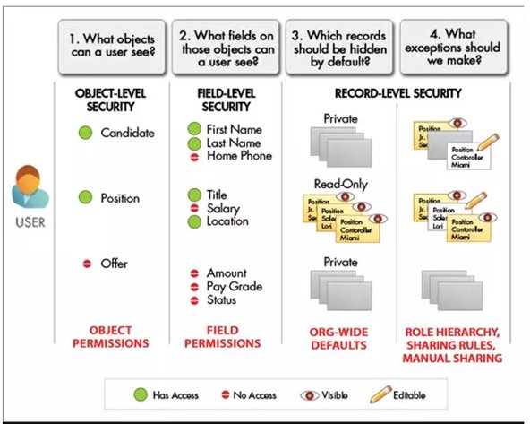
Object Level Security

Slide 5
Object Level Security
Control access to your custom objects with great flexibility
Tab: Display the custom tab for the appropriate users based on their user profiles.​
Object: Set the access for users to create, read, edit, and delete records for each object.​
​Records: ​
-Set the default sharing model for all your users.​
-Determines the users have access to custom object records that they do not own.​

Slide 6
Object Level Security
Relationship: For objects on the detail side of a master-detail relationship, specify the sharing access that users must have to the master record in order to create, edit, or delete the associated detail records.​
This is specified in the Sharing Setting attribute of the master-detail relationship field on the detail object.​
Fields: ​
Set the level of access users have to fields on your custom object page layout.​

Slide 7
Field Level Security

Slide 8
Field Level Security
Restrict users’ access to view and edit fields.​
-Override any less-restrictive field access settings in page layouts and mini page layouts.​
-The most restrictive field access settings of the two: page layout and FLS, always apply.​
-Override less-restrictive field settings in search layouts.​
-Field-level security doesn’t prevent searching on the values in a field.​
-How to set Field Permissions in Permission Sets and Profiles.​
-By Setting Page Layouts and Field-Level Security​

Slide 9
Organization-Wide Defaults

Slide 10
Organization Wide Defaults
-To define the default sharing settings for an organization.
-Achieve Record level access control.
-Provides separate organization-wide defaults for internal and external users.
-Defines a basic level of access that the most restricted user should have.
-Different OWD for different objects.

Slide 11
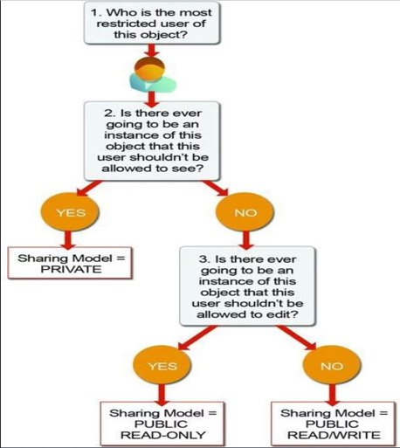
Organization Wide Defaults

Slide 12
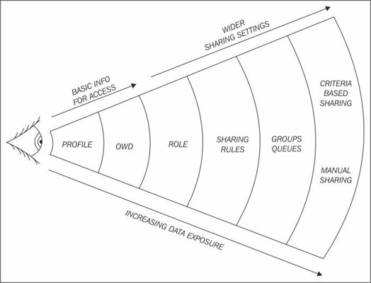
Sharing Rules

Slide 13
User Groups

Slide 14
User Groups
A group consists of a set of users. A group can contain individual users, other groups, or the users in a particular role or territory. It can also contain the users in a particular role or territory plus all the users below that role or territory in the hierarchy.​
You can use groups in the following ways.​
-To set up default sharing access via a sharing rule​
-To share your records with other users​
-To specify that you want to synchronize contacts owned by other users​
-To add multiple users to a Salesforce CRM Content library​
-To assign users to specific actions in Salesforce Knowledge​

Slide 15
Restriction Rules

Slide 16
Restriction rules
Restriction rules allows you to control the records that a specific user group is permitted to see. When a restriction rule is applied to a user, the data that the user has access to via org-wide defaults, sharing rules, and other sharing mechanisms is filtered by the record criteria that you specify in the rule. Salesforce can't guarantee that restriction rules work as intended for end users who are in Salesforce Classic experience. ​
You can create up to two active restriction rules per object in Enterprise and Developer Editions and up to five active restriction rules per object in Performance and Unlimited editions.
Reference:
https://help.salesforce.com/s/articleView?id=sf.dev_security.htm&type=5

Slide 17
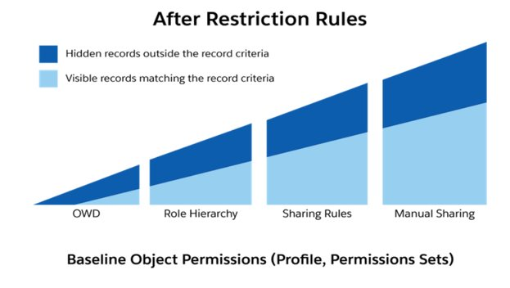
Restriction rules

Slide 18
Reference:
https://help.salesforce.com/s/articleView?id=sf.dev_security.htm&type=5

Slide 19
Thanks
Any Questions ?

